Slide 1
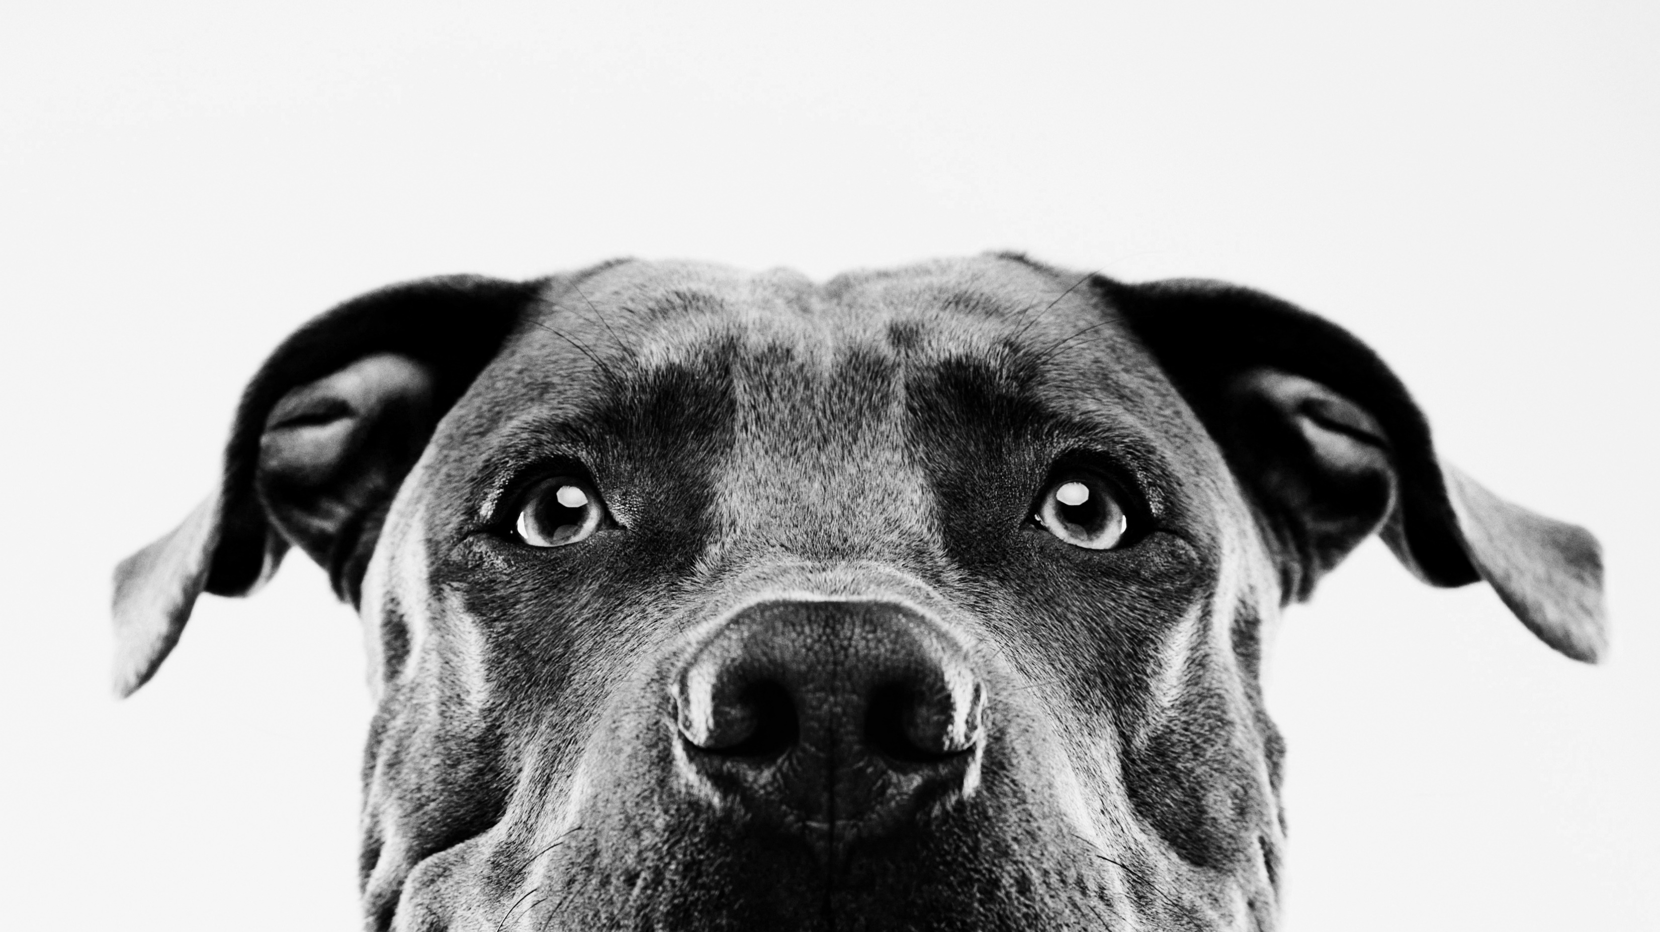
Beta-kindness to animals
April 2, 2025

Slide 2
New members Join Remind
Add the Remind app to your ClassLink page
Accept and sign in without phone number
+ class
Enter class code: beta202425
Type your first and last name
Wait patiently to be approved
Once approved, complete the Microsoft form for
attendance.

Slide 3
Old members find a new member
1.Old member find a new member and go sit with them.
2. Check to see if they are on Remind, if not help them add the
Beta class. Class code: beta202425
3. Once their request to join has been approved, help them find the
Microsoft form. Answer question for attendance.
4. Now, direct them to Montford webpage. Go to Beta page. Review
All the things on page. Especially pointing out the volunteer
log form. Remind them they must print it and fill out all parts.
5. New members, you will need 3 volunteer/community service hours
by the last day of school, 5/23/25.
6. Show them the “Files” section on the Remind app to find meeting
notes, and volunteer/service hour form.
Tell them to check Remind at least once a week to find any other
Beta information, or volunteer opportunities.
8. Answer any questions they might have about Beta.
Buddy up!

Slide 4
Kindness to animals charity drive
Collection dates: APRIL 7- 17
Who are they?
Enrichment toys- Boredom busters/interactive puzzles
Indestructible toys- Kong
Long lasting chews- bully sticks, antlers, etc. No rawhide treats at all!
Peanut butter
Puppy pads
Martingale collars
Leashes
Dry dog food
A North Florida Dog Rescue
Based in Quincy, Florida, located just outside of Tallahassee
Our rescue proudly serves North Florida communities with compassion and dedication.
Earn 2 volunteer hours for every 5 items donated.

Slide 5
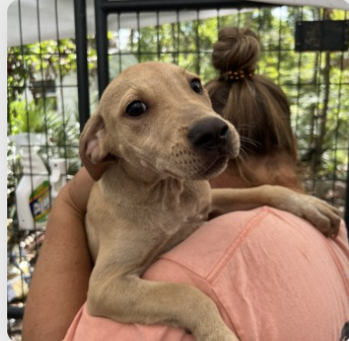
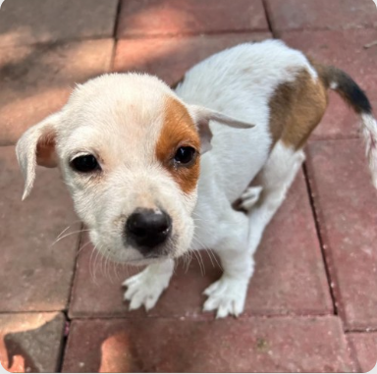
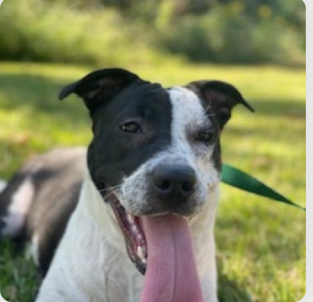
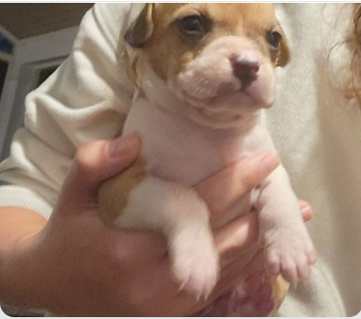
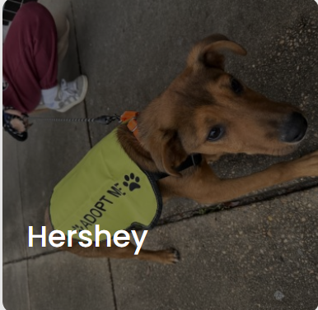
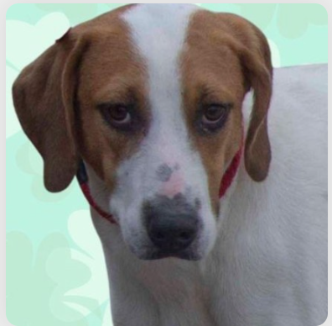
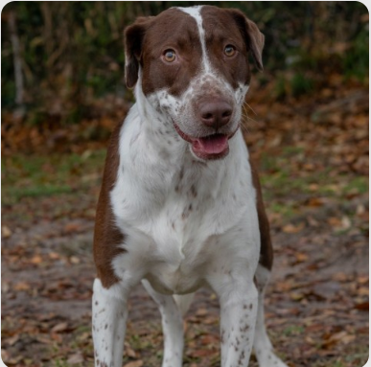
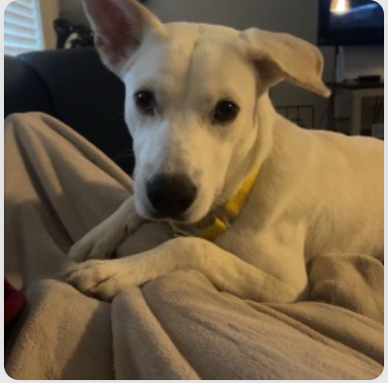
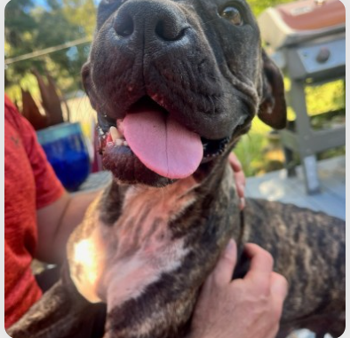
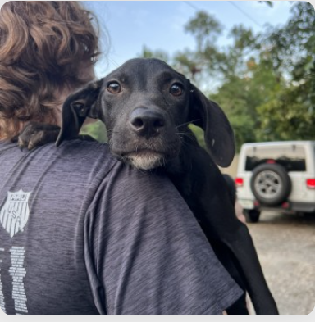
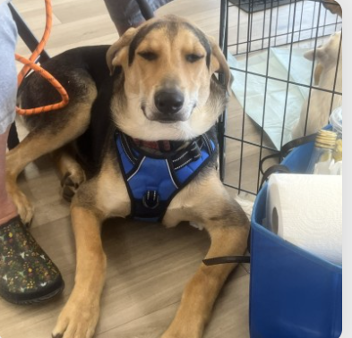
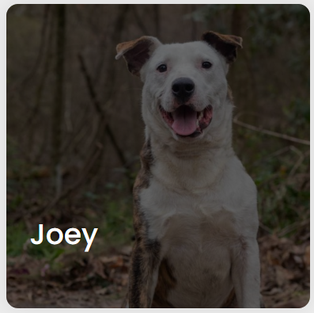
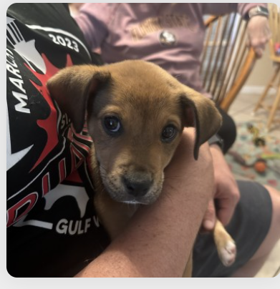
Some of the puppies that need a home and that you will be helping!

Slide 6
Field Trip INFO –APRIL 25th AT HANGAR 38
Attach completed service log ( with at least 10 hours) to the purple form and return to Mrs. Sullivan. If you have turned in forms already, that is fine!
Pay the $15 online through E-funds for school- you will see Beta trip as a choice.
Forms are DUE April 15th. We will open the trip up to new members on the 16th, depending on numbers.
You are responsible for letting your teachers know you will miss class PRIOR to the trip, 1st-4th period
Wear your BETA shirt
Food, drink, bowling and games are all included – you may bring extra money if you want.

